Slide 1
Db present

Slide 2
Organization Structure

Slide 3
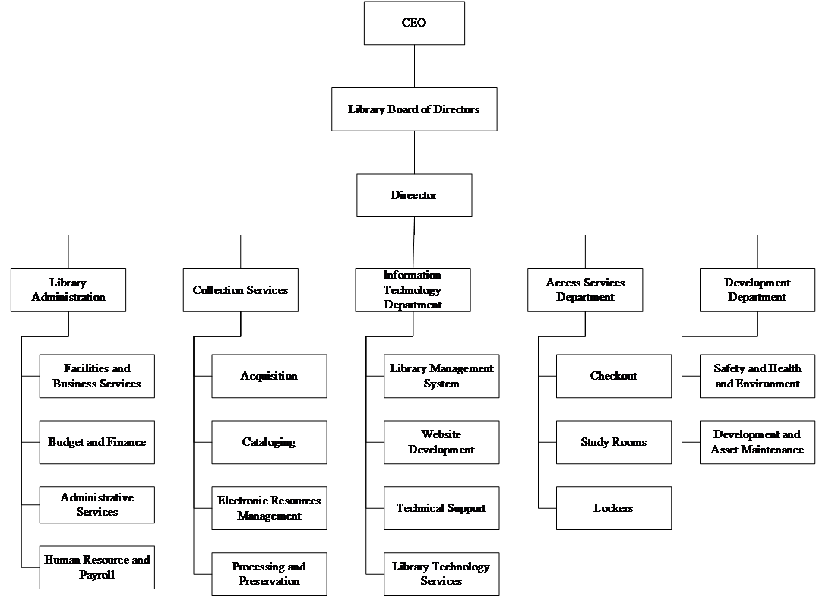

Slide 4
Functional Diagram

Slide 5
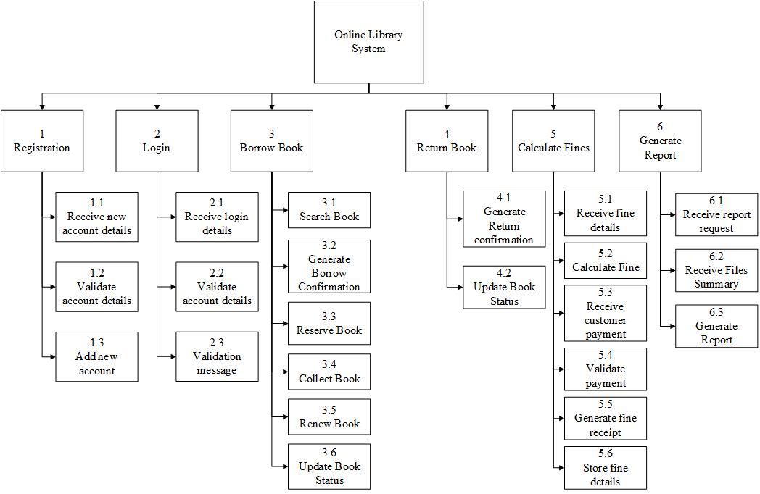

Slide 6
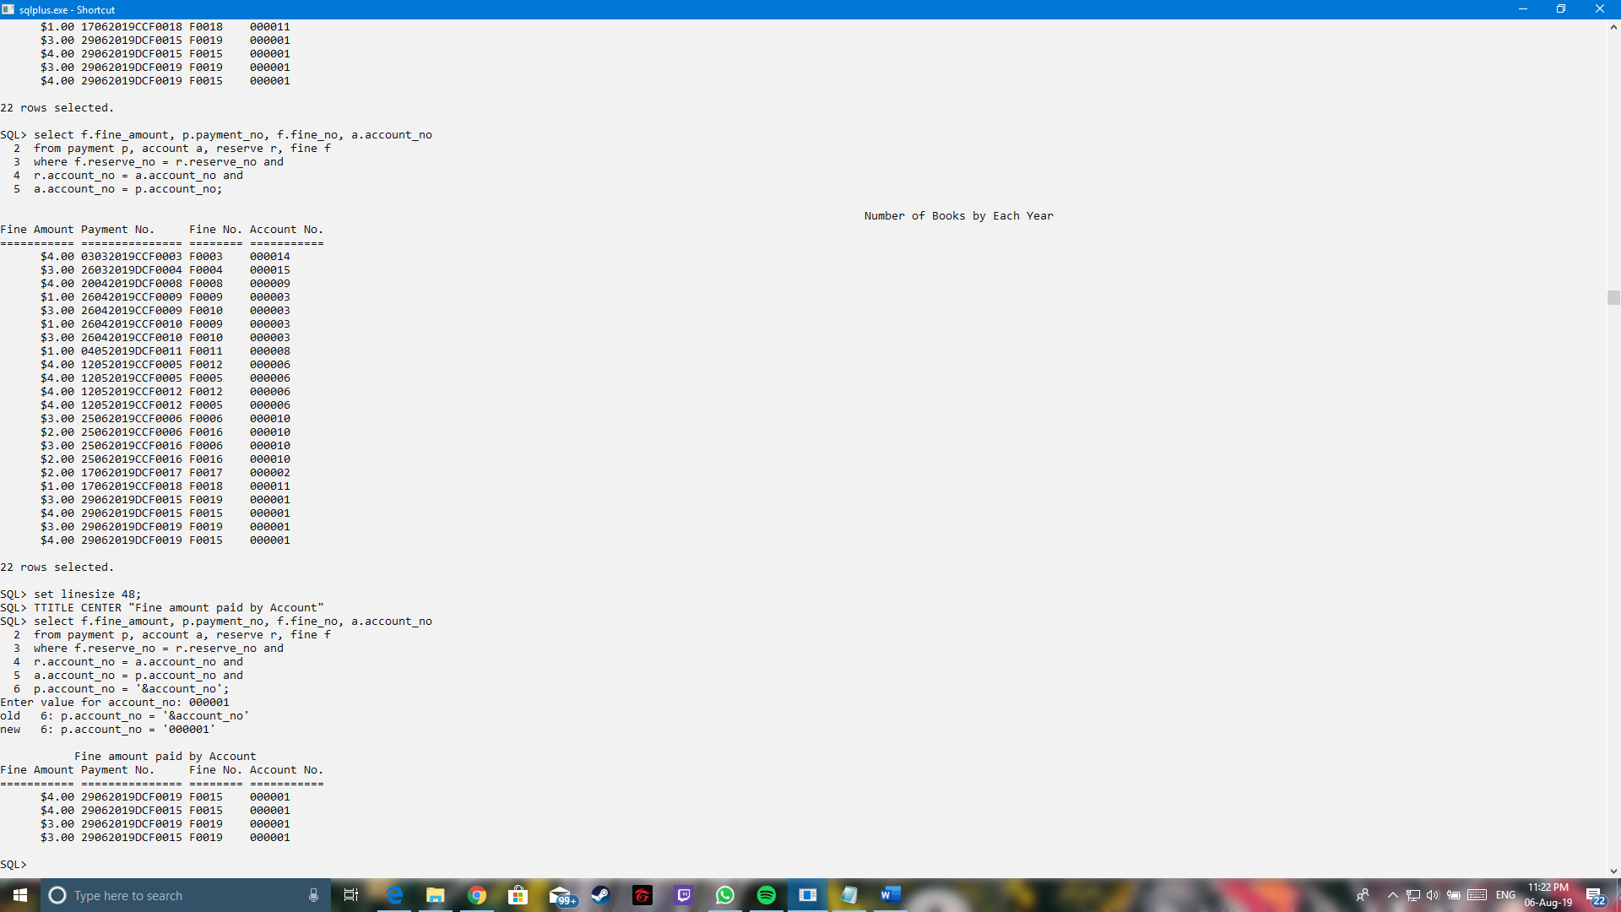
Queries
Purpose:
To make the user easier to search for fine amount paid by certain accounts. This function can be used to increase the efficiency of the staff to perform their work.

Slide 7
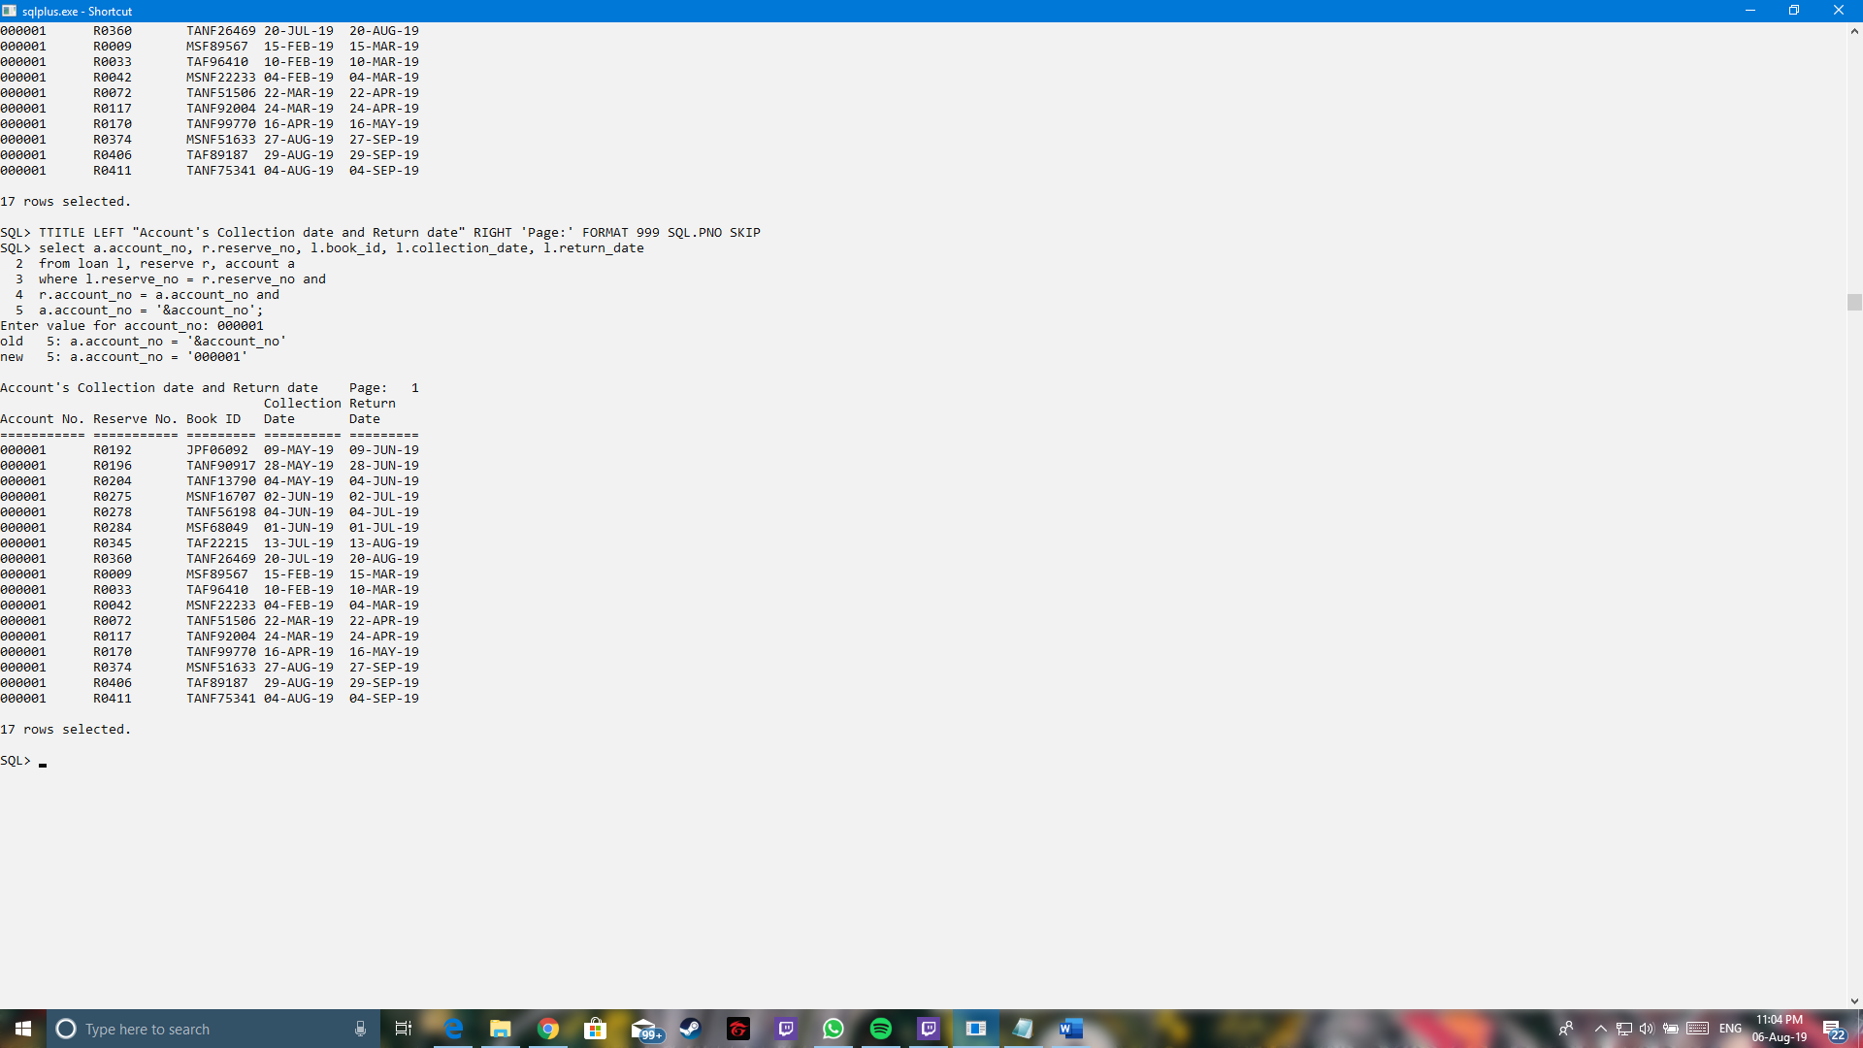
Queries
Purpose:
To make the user easier to search for collection date and return date by certain accounts. This is to increase the efficiency of the staff to perform the searching of the accounts’ details.

